Slide 1
Data Representations
Unit 1

Slide 2
Arithmetic
Binary Addition
Binary Subtraction
Binary Multiplication
Binary Division

Slide 3
Binary Addition
Rules:-
0 + 0 = Sum of 0 with a carry of 0
0 +1 = Sum of 1 with a carry of 0
1 + 0 = Sum of 1 with a carry of 0
1 + 1 = Sum of 0 with a carry of 1

Slide 4
Binary Subtraction
Rules:-
0 - 0 = 0
1 -1 = 0
1 - 0 = 1
10 - 1 =1
0 – 1 with a borrow of 1

Slide 5
Binary Multiplication
Rules:-
0 * 0 = 0
0 * 1 = 0
1 * 0 = 0
1 * 1 = 1

Slide 6
SIGNED NUMBERS( Integer Representation)
Signed numbers can be represented as both positive and negative numbers
There are 3 representations for Signed Numbers
Signed magnitude representation
Signed 1's complement representation
Signed 2's complement representation

Slide 7
Example: Represent +9 and -9 in 8 bit-binary number
Only one way to represent +9 ==> 0000 1001
Three different ways to represent -9:
In signed-magnitude: 1 0001001
In signed-1's complement: 1 1110110
In signed-2's complement: 1 1110111

Slide 8
Represent the following numbers in signed-magnitude, signed-1's complement, and signed-2's complement
1. -13 and +13
in signed 2s complement 8 bit,
-13 = 2s complement(00001101) = 11110011
2. -17 and +17
3. -25 and +25

Slide 9
Complement
Computers uses complemented numbers to perform subtraction.
In binary number system there are 2 types of complement – 1’s and 2’s complement
Similarly, in decimal number system there are 2 types of complement – 10’s and 9’s complement

Slide 10
1’s Complement
To get 1’s complement convert 0’s to 1 and 1’s to 0’s.
Eg: 1’s complement of 10010 is 01101
1’s complement of 1111 is 0000

Slide 11
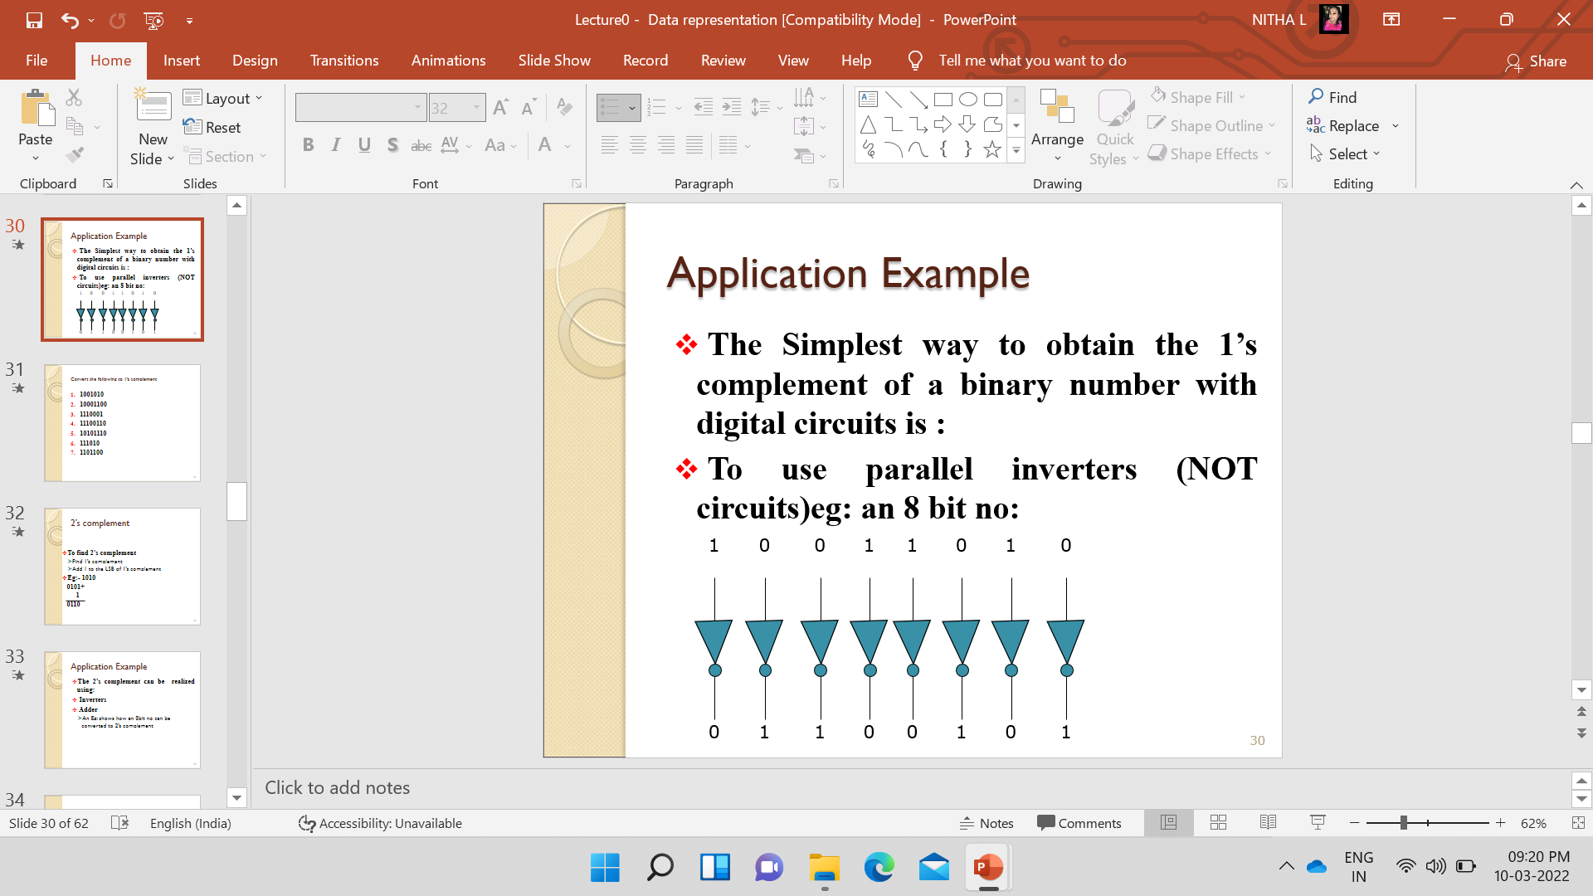
Application Example
The Simplest way to obtain the 1’s complement of a binary number with digital circuits is :
To use parallel inverters (NOT circuits)
Eg: an 8 bit no:

Slide 12
Convert the following to 1’s complement
1001010
10001100
1110001
11100110
10101110
111010
1101100

Slide 13
2’s complement
To find 2’s complement
Find 1’s complement
Add 1 to the LSB of 1’s complement
Eg:- 1010
0101+
1
0110

Slide 14
Application Example
The 2’s complement can be realized using:
Inverters
Adder
An Eg: shows how an 8bit no can be converted to 2’s complement

Slide 15
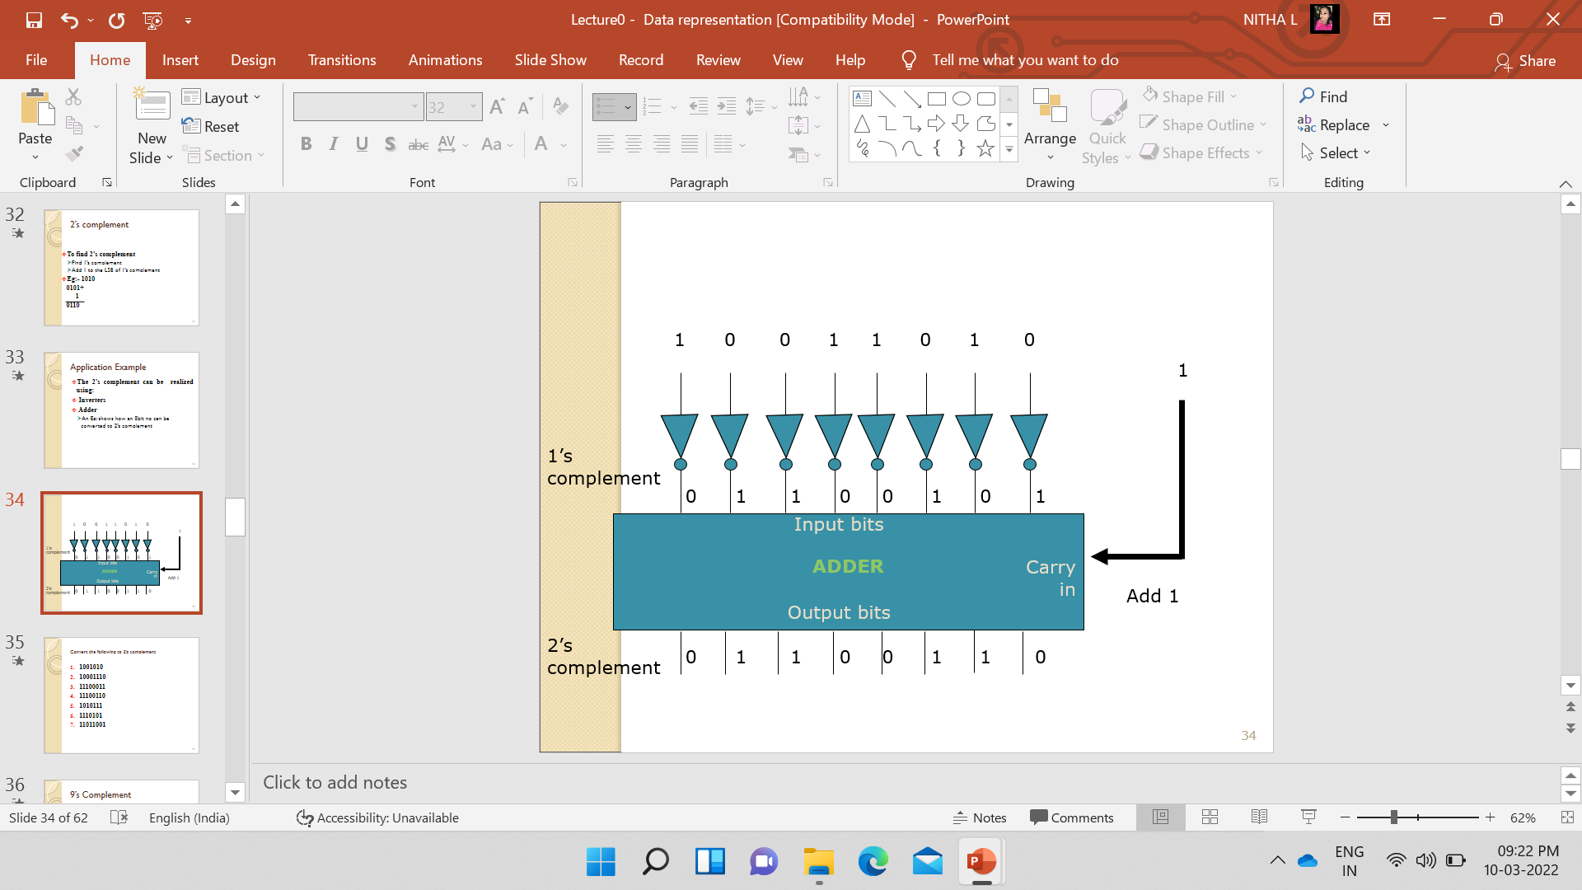

Slide 16
Convert the following to 2’s complement
1001010
10001110
11100011
11100110
1010111
1110101
11011001

Slide 17
9’s Complement
The 9’s complement of a decimal number is obtained by subtracting each digit of the number from 9.
Eg:- 9’s complement of 2 is 7 and
9’s complement of 123 is 876
999 -
123
876

Slide 18
Convert the following to 9’s complement
25
456
122
101
111
345
342

Slide 19
10’s Complement
10’s complement of a decimal number is obtained by adding one to the 9’s complement of that number.
Eg: 10’s complement of 2
9-
2
7+
1
8

Slide 20
Convert the following to 10’s complement
254
453
123
102
1110
324
376

Slide 21
Find 1’s and 2’s complement
1. 11010101
2.11011011
3. 10110010

Slide 22
Logic Operations
Perform the following Logic operations
10110101 v 1100110
11001101 v 1000110
10010101 Λ 1100111
11101001 Λ 1101110
11010011 ⊕ 1101110
11101101 ⊕ 1101100

Slide 23
IEEE754 STANDARD
Computers have various architectures designed by different vendors like Intel, AMD, ARM, etc.
How do computers interpret various number formats?
If there are various representations for these different architectures, then it will create chaos and ambiguity.
So there should be a common agreement between all the processor vendors for handling the data.
This common standard is the IEEE754 standard.

Slide 24
Data type representation
Two types of Representation
Fixed Point - A fixed-point number means that there are a fixed number of digits after the decimal point
Floating Point- A floating point number does not reserve a specific number of bits for the integer part or the fractional part.

Slide 25
Fixed Point Number
A fixed point number has a specific number of bits (or digits) reserved for the integer part and a specific number of bits reserved for the fractional part.

Slide 26
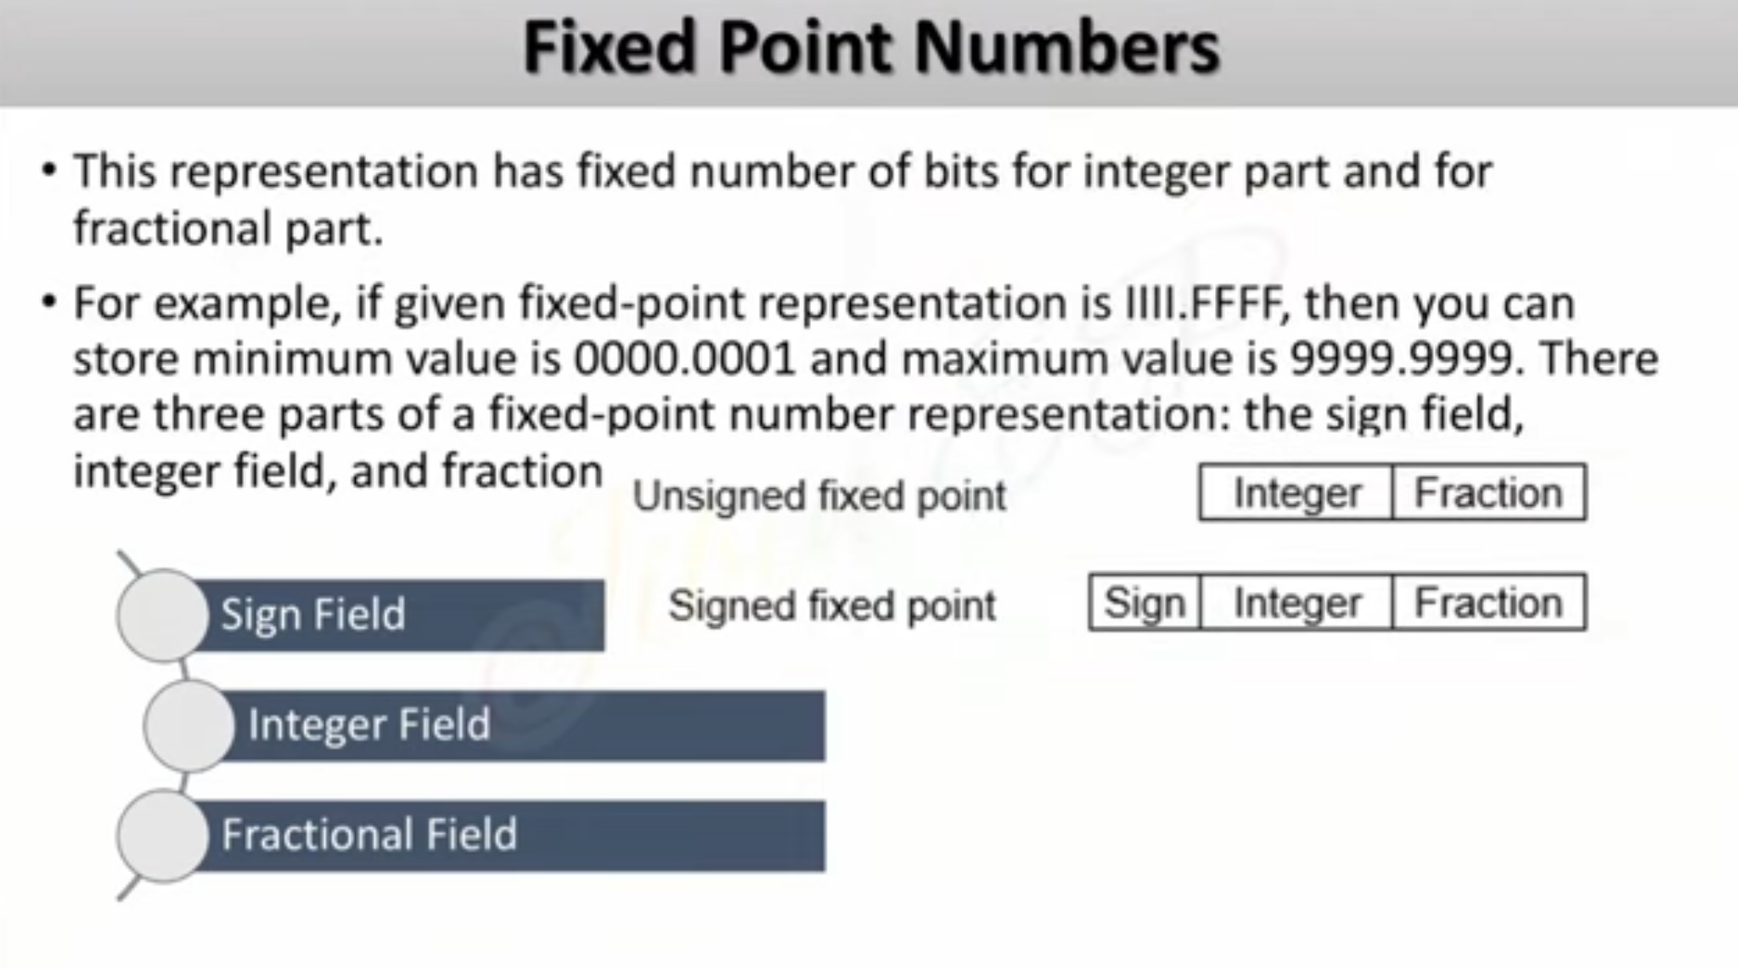

Slide 27
Examples of Fixed Point representations
Compute 0.75 + (-0.625) using Fixed point numbers
Step 1 Rep. 0.75 in Binary (4 bits for Integer and 4 bits for fraction)
0.75 ---- 0000.1100
Step 2 -Rep 0.625 in binary
0.625 ---0000.1010
Since it is (-0.625) we have to find the
2’s complement
Step 3 – Since the second no is a negative number, find the 2’s complement of it
(-0.625) --- 1111.0110
Step 4 – Now Add both the numbers
0.75 x 2 = 1.5 - - 1
0.5 x 2 = 1.0 - - 1
0.0 x 2 = 0 - - 0
0.625 x 2 = 1.250 - 1
0.250 x 2 = 0.500 - 0
0.500 x 2 =1.000 - 1 0.000 x 2 =0.000 -0
0000.1100 +
0110
1)0000.0010

Slide 28
0.5+0.250
−0.75+0.375
1.125+−0.625
−2.5+1.75
3.0−1.5

Slide 30
32 bit representation of Fixed point numbers
Assume the number using 32 bit format which reserves 1 bit for the sign, 15 bits for integer part and 16 bits for fraction part. The number is (-43.625)
43 = 101011
.625 =1010
Since the given no is a negative no.the sign bit is 1.
43.625 – 000 0000 0010 1011. 1010 0000 0000 0000
Sign(1 bit)
Integer (15 bits)
Fraction (16 bits)
000 0000 0010 1011 1010 0000 0000 0000
1

Slide 31
Fixed-Point (Practice Questions)
Decimal → Fixed-Point Representation
Represent 25.75
Represent +25.75
Represent –12.5
Represent +0.125
Represent +145.3125

Slide 32
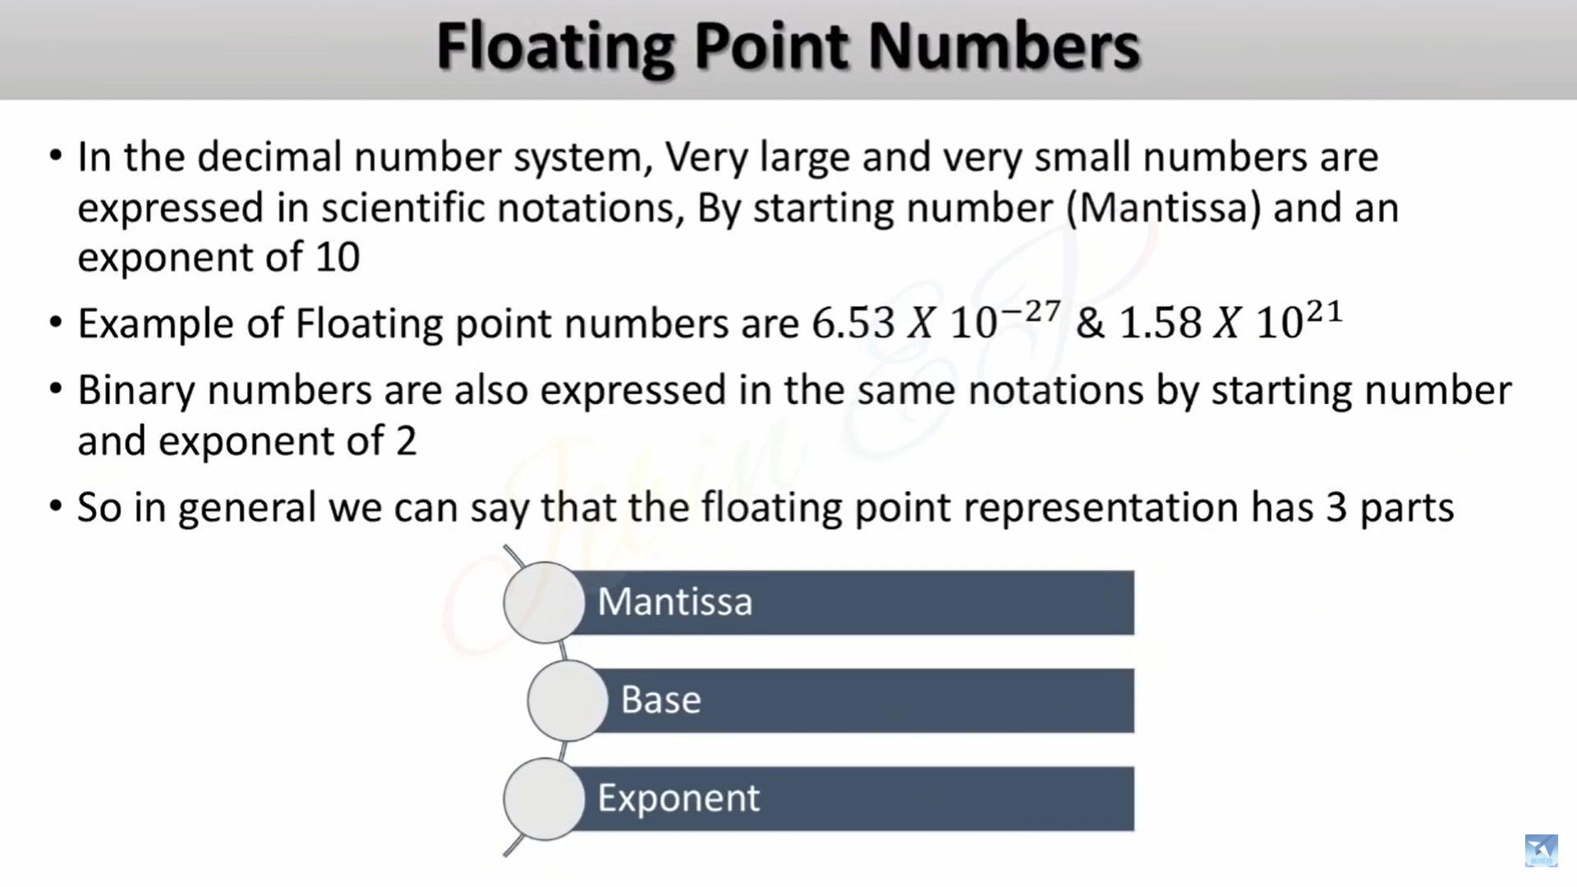

Slide 33
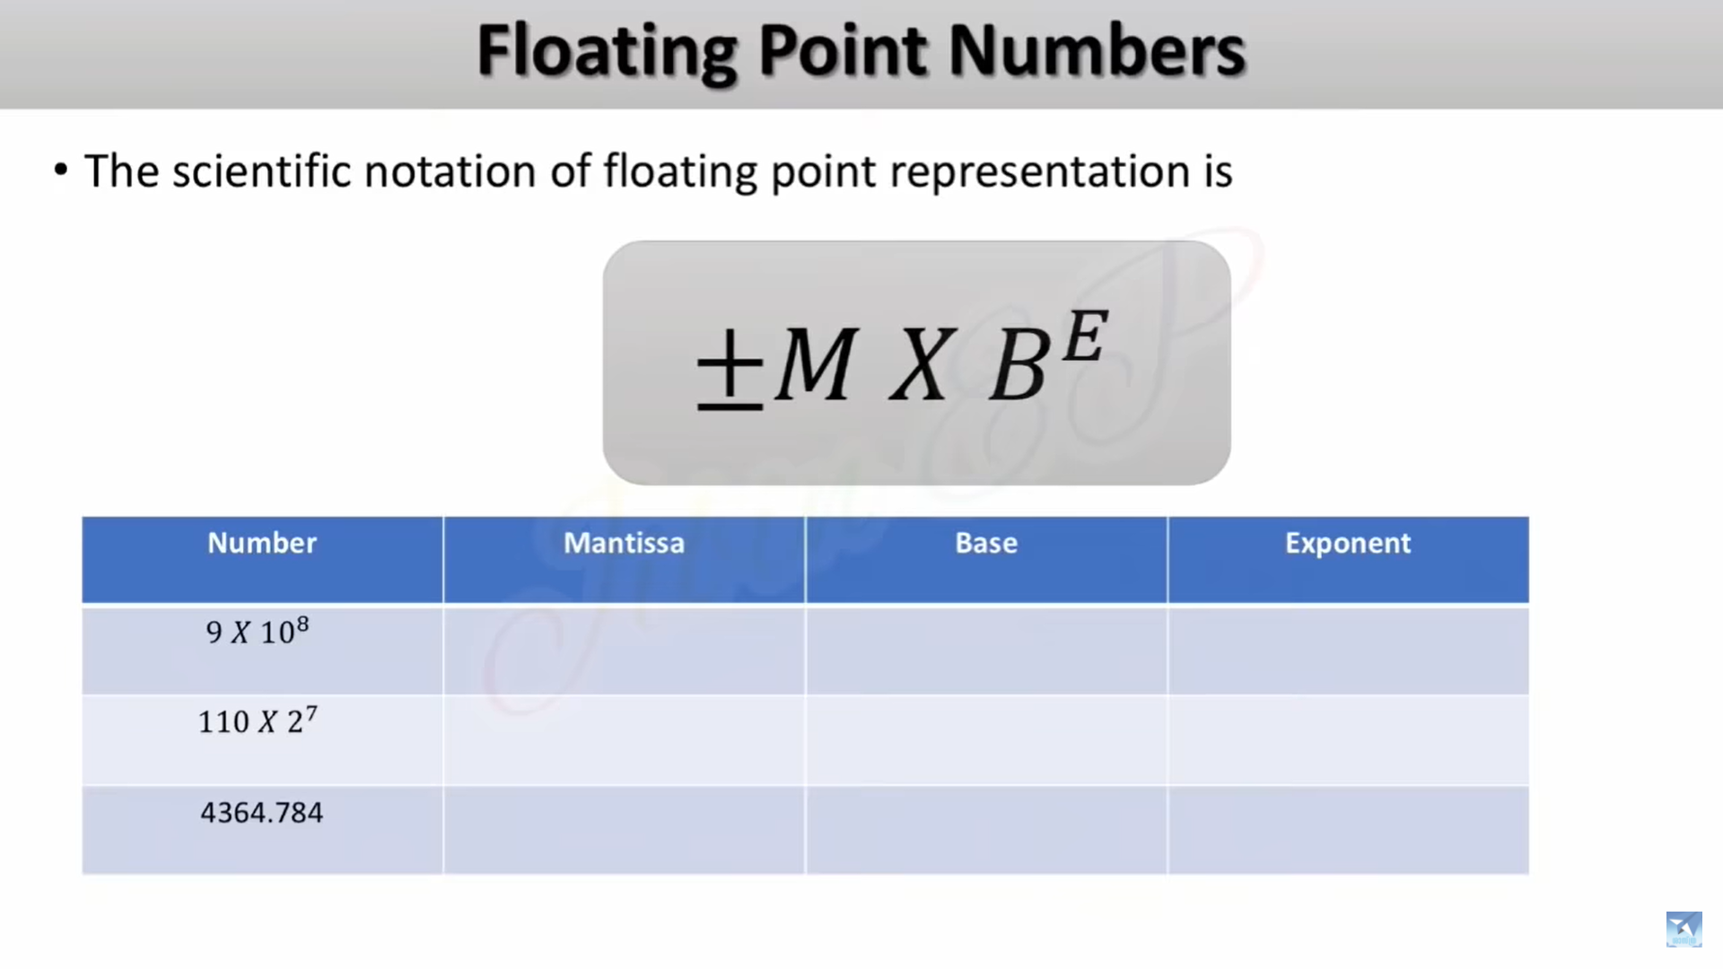

Slide 34
NUMBER | MANTISSA | BASE | EXPONENT
9 X 10⁸ | 9 | 10 | 8
110 X 2⁷ | 110 | 2 | 7
4364.784 | 4364784 | 10 | -3
110.101010 | 110101010 | 2 | -6

Slide 35
IEEE 754 floating point representation
IEEE Standard 754 floating point is the most common representation today for real numbers on computers, including Intel-based PC’s, Macs, and most Unix platforms.
Two types
Single precision
Double precision

Slide 36
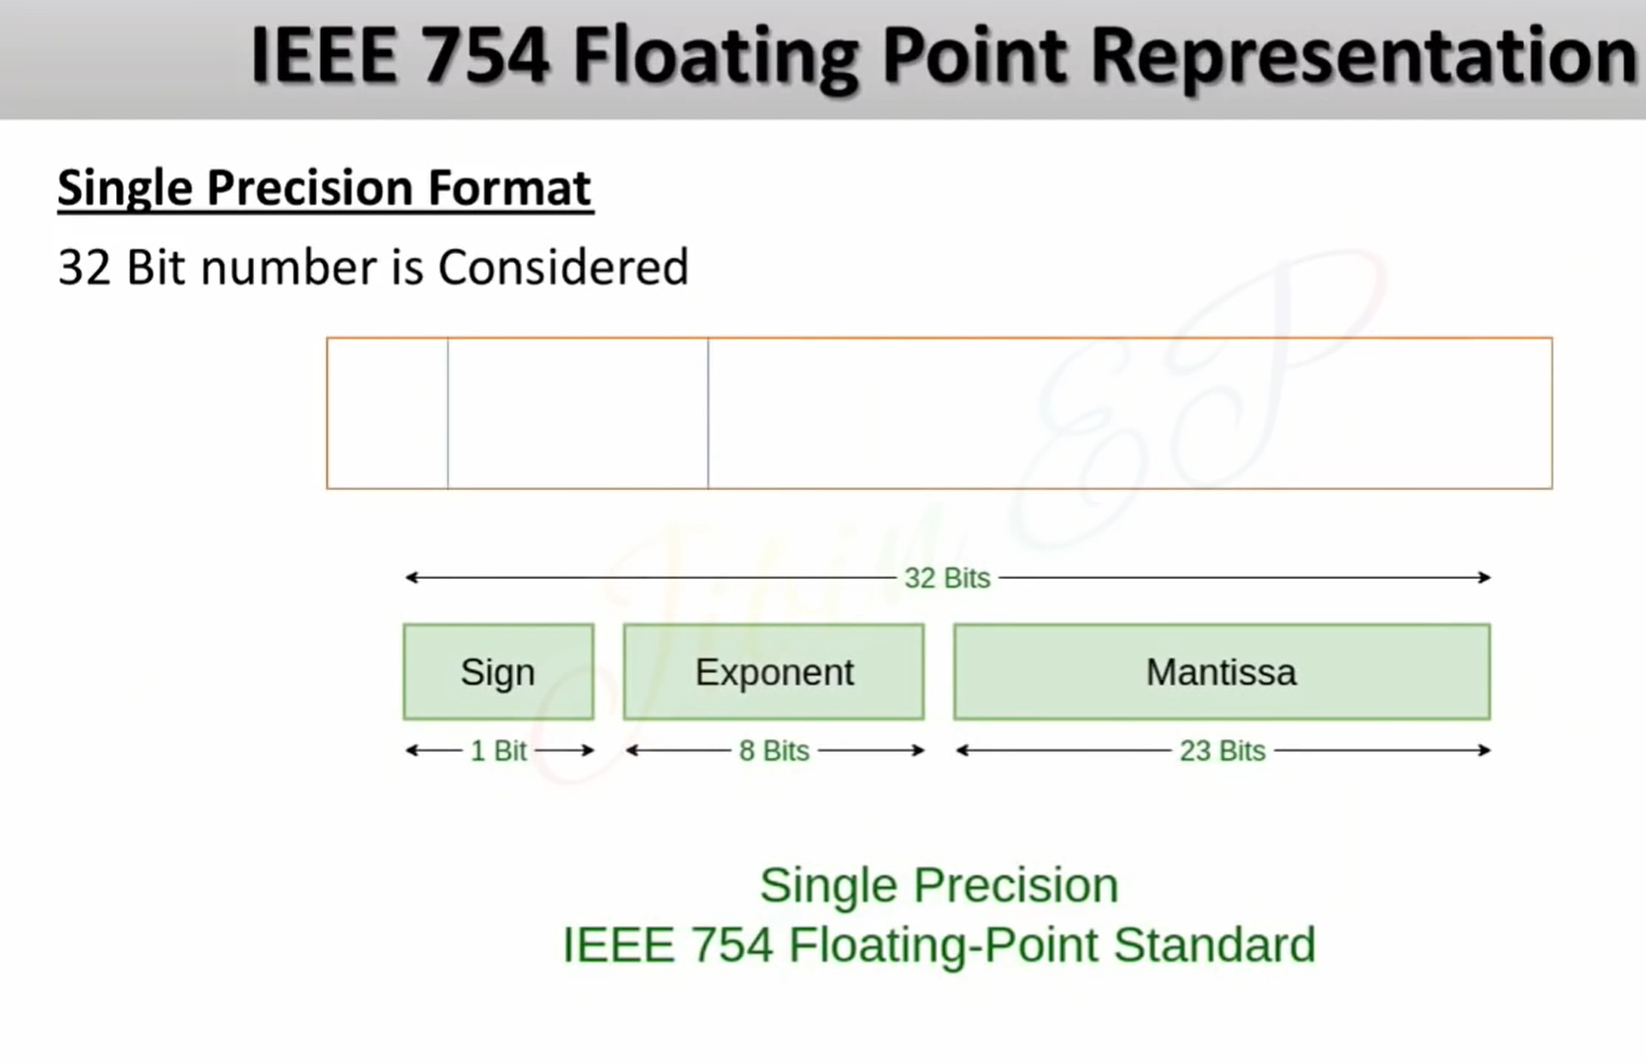
Sign
(1 bit)
Exponent
23-30 bits)
Mantissa (0-22 bits)

Slide 37
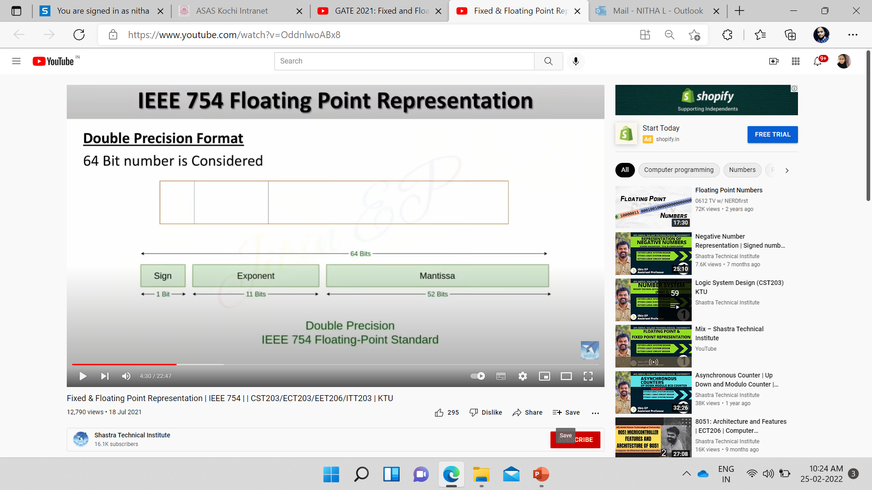
Sign
(1 bit)
Exponent
(52-62)
Mantissa (0-51)

Slide 38
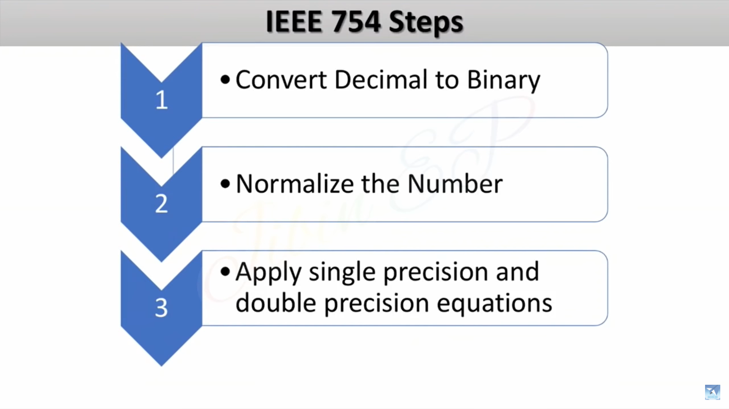
How to find single and double precision of a number?

Slide 39
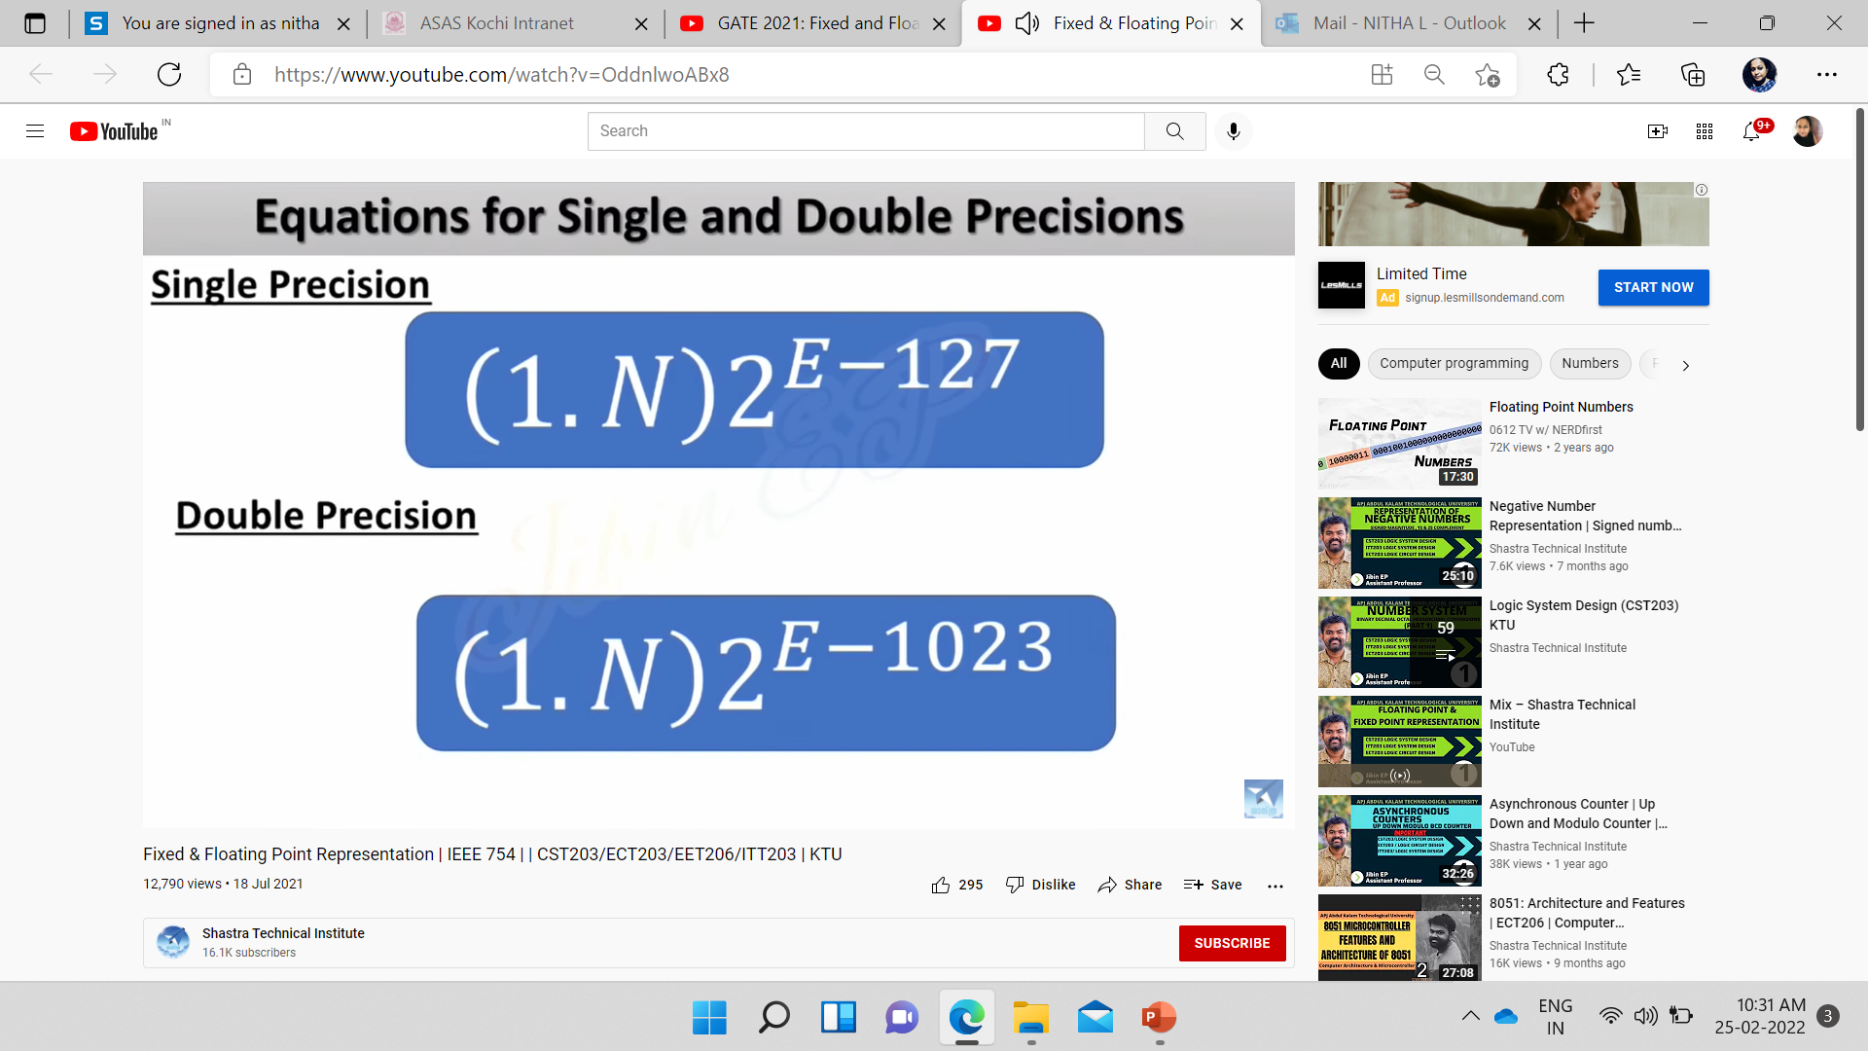
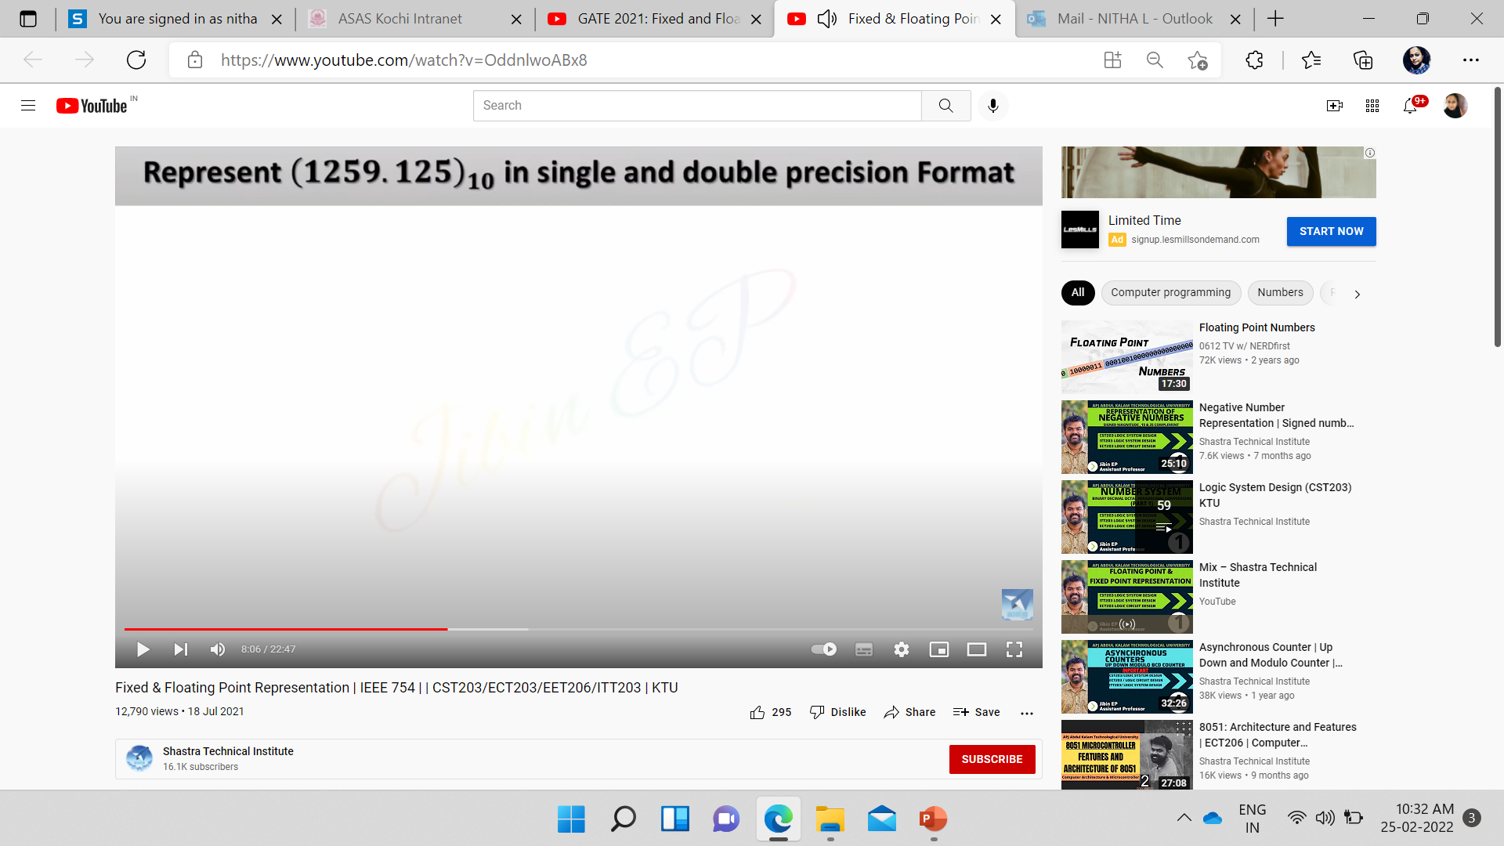

Slide 40
(1259.125)10 = 100 1110 1011.001
Step 1 Convert to binary
100 1110 1011.001
Step 2 Normalize the Number
(1.N)2^{E-127} - Single Precision (127 means 128 bits)
(1.N)2^{E-1023} - Double Precision(1023 means 1024 bits)
1 00 1110 1011.001
1. 00 1110 1011001 x 2¹⁰
N
(After the decimal point, there are 10 numbers , so E=10)

Slide 41
Step 3 Apply Single precision format
(1.N)2 ^{E-127}
1. 00 1110 1011001 x 2¹⁰
(137)10 = (1000 1001)2 → E
Single Precision Format :
We need to find Exponent
[E-127 =10]
E =127+10
= 137
31
Sign
30
Exponent
23
22
Mantissa
0
0
10001001
0011101011001…..000
1 bit (S)
8 bit (E)
23 bit (M)

Slide 42
DOUBLE PRECISION
(1259.125)10 = 100 1110 1011.001
Step 1 Convert to binary
100 1110 1011.001
Step 2 Normalize the Number
(1.N)2^{E-1023} - Double Precision(1023 means 1024 bits)
1 00 1110 1011.001
1. 00 1110 1011001 x 2¹⁰
N
(After the sign bit, there are 10 numbers , so E=10)

Slide 43
Step 3 Apply Single precision format
(1.N)2 ^{E-1023}
1. 00 1110 1011001 x 2¹⁰
(1033)2 = (100 0000 1001)2 → E
Double Precision Format : 1024 bits
[E-1023 =10]
E =1023+10
= 1033
63
Sign
62
Exponent
52
51
Mantissa
0
0
100 0000 1001
0011101011001…..000
1 bit (S)
11 bit (E)
52 bit (M)

Slide 44
1358.130
14.25

Slide 45
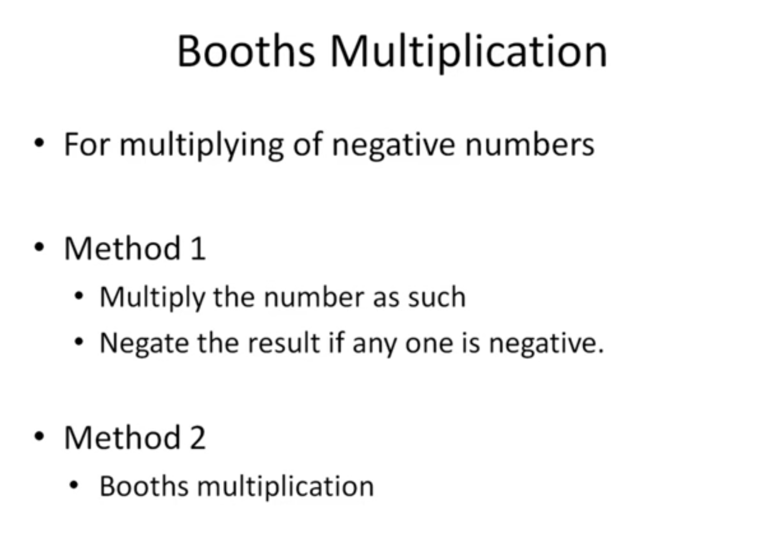

Slide 46
Booth's Multiplication Algorithm is a method used to perform signed binary multiplication efficiently.
﻿﻿It reduces the number of arithmetic operations by encoding the multiplier in a way that minimizes the number of addition and subtraction steps.
﻿﻿This algorithm is widely used in computer architecture for fast binary multiplication.

Slide 47
STEPS
﻿﻿STEP 1: Initialize the multiplier, multiplicand, and product registers.
﻿STEP 2: Extend the multiplier with one extra bit (0) at the right.
﻿STEP 3: Based on the current and previous bits of the multiplier:
10: Subtract the multiplicand from the product.
01 : Add the multiplicand to the product.
00 & 11 : No arithmetic operation.
﻿STEP 4 :Shift the product right by one bit.
﻿STEP 5: Repeat the process until all bits are processed.

Slide 48
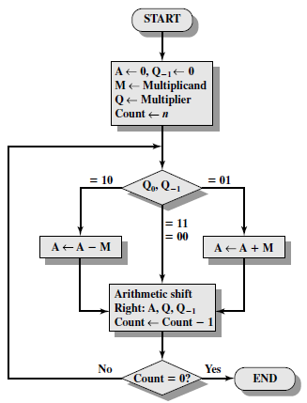
BOOTH’S ALGORITHM

Slide 49
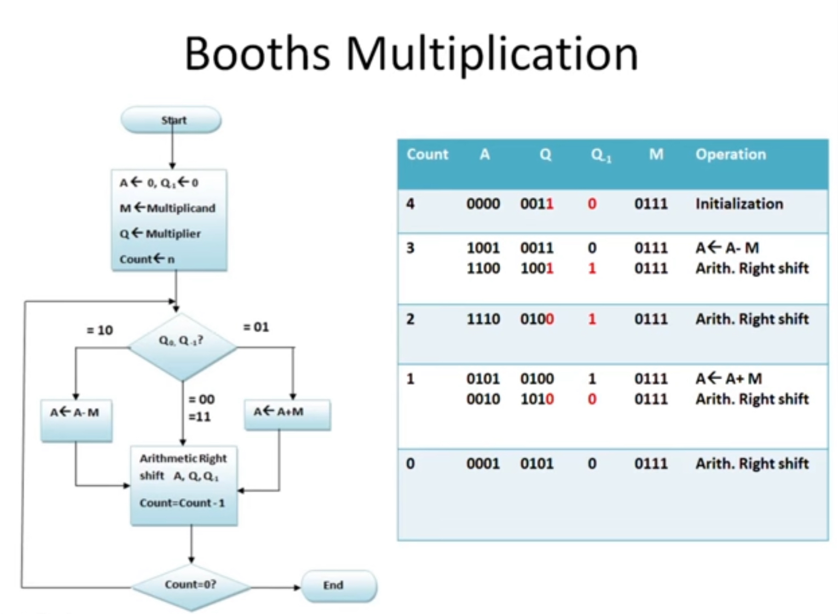

Slide 50
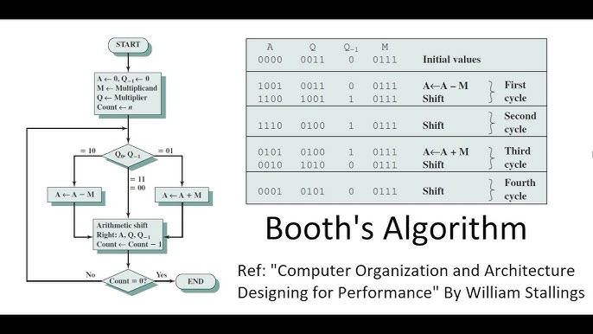

Slide 51
END

